Slide 1



Web-Based Facial Authentication System

Slide 2
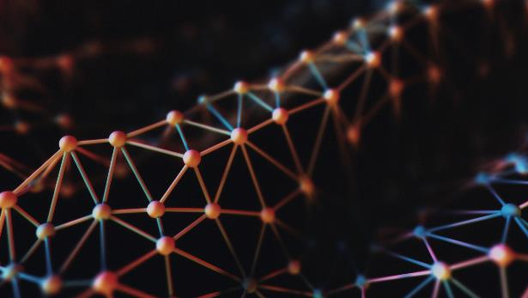
Group Members
2010030272 -Gilla Samanth
2010030031-Cheethirala Varun 2010030055-Gande Saiteja

Slide 3

Abstarct
Information and Communication Technology usage has witnessed rapid growth in the past decade decade all around the world. All web-based systems that have users and store personal information about the users require a mechanism to keep track of their users’ information. commonly every user of the system is assigned an instance in the database that represents them (their identity). To protect the user identity, an authentication and authorization mechanism is implemented to control access to certain information. The most common method in web-based systems is authentication using passwords. passwords have well-known disadvantages in both usability and security. This leads to promotion of Face-based authentication.

Slide 4
Introduction
In the present time, face recognition is a popular and important technology integrated in many applications such as payment, door unlock, video monitoring systems, etc. A face recognition system is a technology that can identify and verify people from digital images and footage.So we decided to use the same face recognition approaches for web authentication for improving the security in websites and bringing a new approach in web authentication.

Slide 5
Advantages
Protection against password list and phishing
Password theft is not possible with facial authentication
It protects against brute force attacks
It enhances your cyber security posture
User no need to remember any passwords.

Slide 6
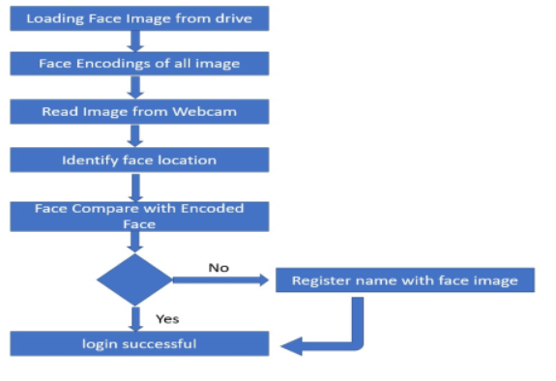
Flow Chart:

Slide 7
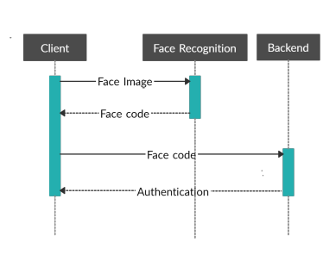
Process

Slide 8

RESULT

Slide 9
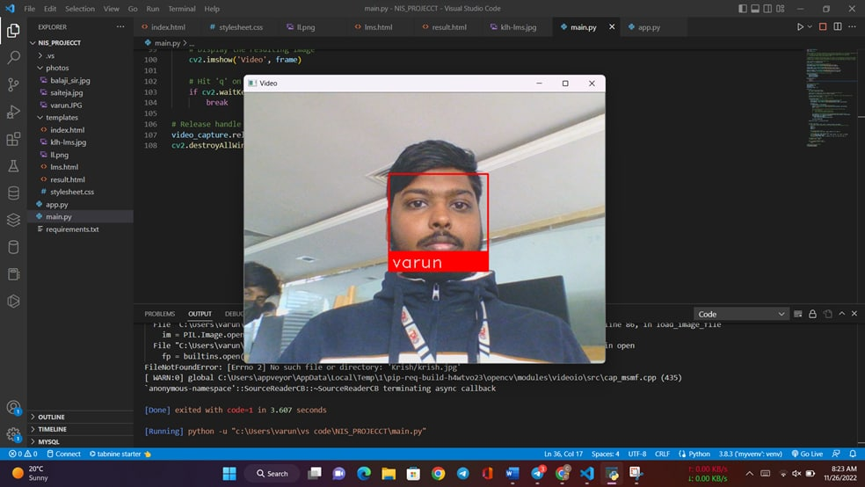
Result

Slide 10

GIT HUB

Slide 11
Conclusion
face recognition is an emerging technology that can provide many benefits. face recognition can save resources and time they are far from ideal to perform adequately in all situations form real world. it will detect faces via webcam and then recognize the faces. it capturing live images from camera and applying different techniques of face detection and face recognition which will reduce manual or traditional work also time takes to login the system is fast because it encodes data automatically itself in background.

Slide 12


